Slide 1
Open food consumption maps

Slide 2
Open data rocks !
EU open its data
All governments open their data
EFSA has decided to open it’s data
EFSA strategy about openness and transparency

Slide 3
Food consumption data rocks !
Food risk assessment = exposure assessment + hazard characterisation
Exposure assessment = food consumption / body weight
Used every day in EFSA

Slide 4
Maps rock !
EFSA serves EU citizens
Citizens care about their region and country -> EFSA should show to the citizens data of their region (and all other EU regions)
-> EFSA should create maps

Slide 5
Map making with R rocks !
Open source software
Free and accessible to everybody
Libraries for everything
To create the demo took me one hour of work

Slide 6
Open food consumption data rocks !
EFSA has open its food consumption database: https://dwh.efsa.europa.eu/bi/asp/Main.aspx?rwtrep=006
Demo of open food consumption maps: https://efsa.shinyapps.io/analyseFCD/

Slide 7
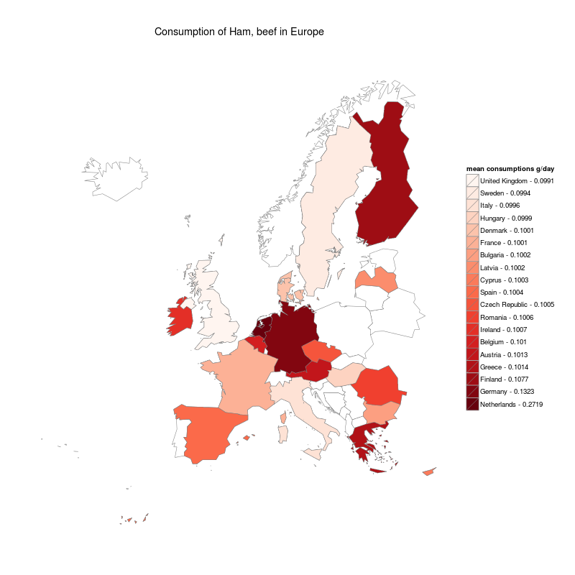

Slide 8
Concrete proposal
EFSA should create and publish examples of interactive maps showcasing our food consumption data
In an 'blog' type of article, including publishing examples of the underlying data and the R code to create the maps
They should use R libraries, which makes sure that the maps can be consumed by everybody without the need of any non-open software
This should inspire others to use our data

